Slide 1

Meme Workshop
Open the Setup and Workshop Slides @ http://ap.pn/2n6EbzK
& Start your emulator
(C) 2017 Appian Corporation. Distribution with attribution permitted. All other rights reserved
Notes:
Images
Android: https://commons.wikimedia.org/wiki/File:Android_robot.png licensed by: Google, with: https://creativecommons.org/licenses/by/3.0/deed.en

Slide 2
Agenda
Dissecting an Android App
Views
Activities
Layouts
Intents
Networking
Other Cool Stuff

Slide 3
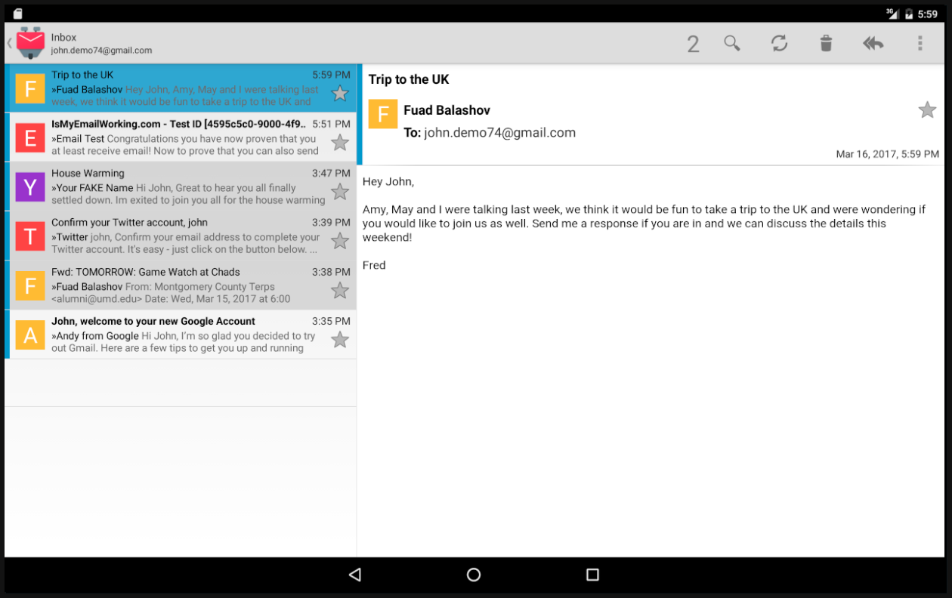
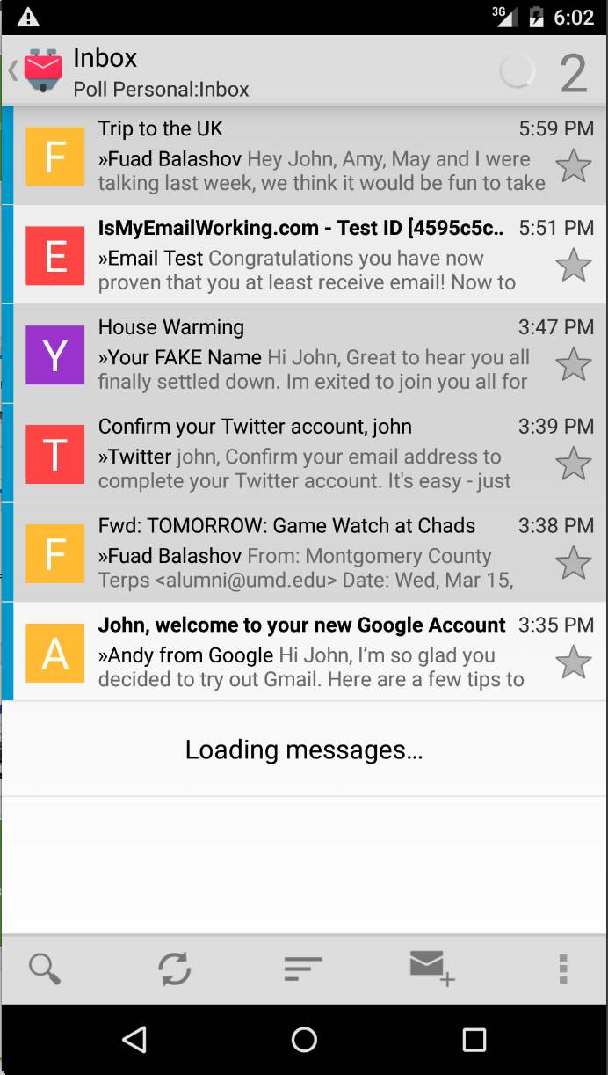
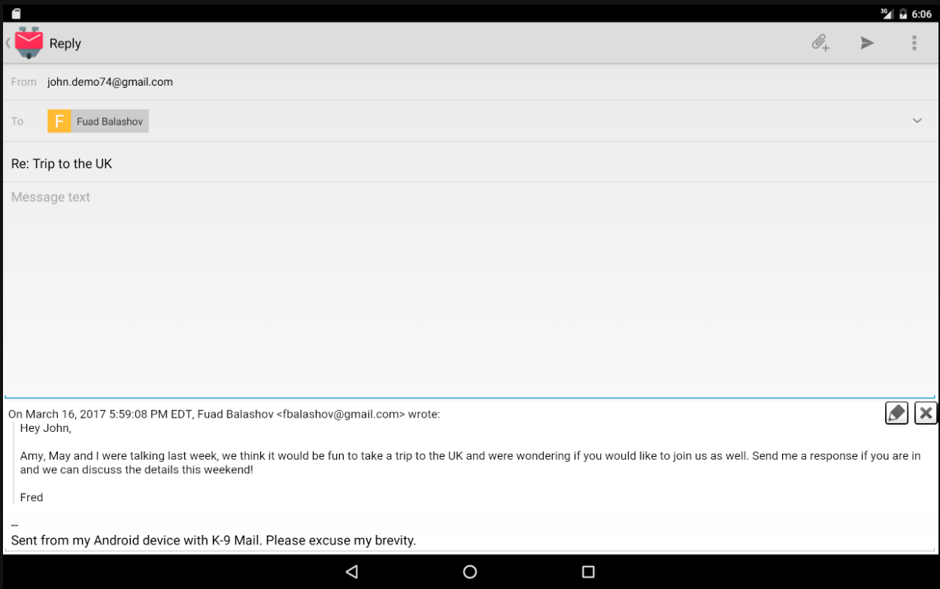
Dissecting an Android App
Activities
Intents
Views
Background Processing
Notes:
We are using k-9 mail, an open source android mail app for this illustration
What does an android app have?
For this exercise we will be exploring a fictional mail app, lets call it… GMayle!
For starters we have different screens
These screens are called activities in android
We also note that we need a way to navigate from one to another, and that the navigations (unlike on web) are well defined.
Navigations in android are handled with intents
If we focus on one of these activities we will see that there are panels of content
These panels are called fragments
If we drill down even further we can see that there are are different smaller “views” in the UI (for images, text, etc)
These are called views and view groups in android
Finally, we should note that while the Layout is defined by the application the data is not hardcoded in the app, it is pulled from local databases/filesystems and the server
This data is loaded with async tasks and loaders

Slide 4


Your Toolbox
XML
Defines UI
Java
App Logic
Android
+
=
Notes:
Now that we have an idea of what components make up an application lets talk about the toolbox we have to build them!
This consists of XML and Java (maybe ignore android framework here…
XML is used to build the UI’s of the application (Layouts, animations, etc)
Java is used for putting together our application logic
Images
Xml icon from: https://commons.wikimedia.org/wiki/File:Text-xml.svg licensed by RRZEicons with: https://creativecommons.org/licenses/by-sa/3.0/deed.en
Java icon from: https://www.flickr.com/photos/daniel_iversen/15090961835 licensed by Daniel Iversen with: https://creativecommons.org/licenses/by/2.0/

Slide 5
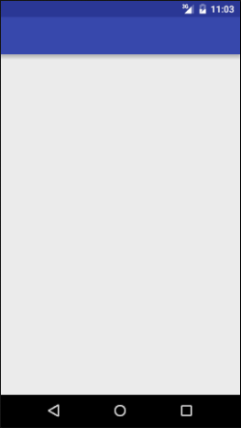

Let’s Build an App
Activity
Type a Number
Intent
Activity
View a Meme
Network
AsyncTask
Number Id
Data
Notes:
Make sure to point out where resources and java files go.
In this project we will be touching on:
Views, Activities, Intents & AsyncTasks
Also: gradle, project filestructure
The Manifest
Images:
Android screenshots by appian

Slide 6

Views
<ImageView
/>
android:layout_width="wrap_content"
android:layout_height="wrap_content"
android:src="@drawable/peaceful_road"
Notes:
Ben Edgar
XML files consist of Tags and attributes. (image1 here: one xml element + image2 the element it describes)
Tags
are surrounded by angle brackets
have a name
Describe a UI component
Attributes
are listed within a tag
customize the component they describe
sometimes necessary (width, height), just listen to the errors in Android Studio!
Images
Road from: https://pixabay.com/en/road-distance-landscape-horizon-348544/

Slide 7
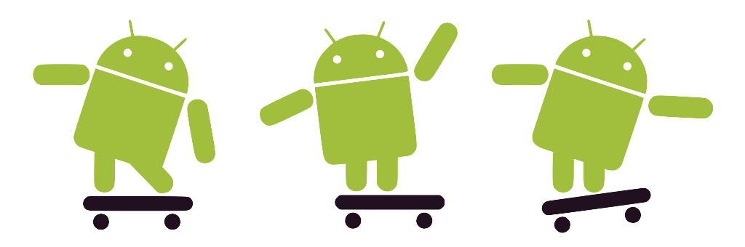
Let’s Build a Button
See the changes here!
Notes:
Add button xml to activity_main.xml file
Specify length and width to be wrap_content
Specify text to be “Click me!”
Think about error to make!
Images
Androids: https://commons.wikimedia.org/wiki/File:Android_robot_skateboarding.svg licensed by: Bersam, with: https://creativecommons.org/licenses/by/3.0/deed.en

Slide 8
Activity: Managing Events
Responds to UI events
clicks, touches, scrolls
Notes:
Each activity is represented with a Java class that you write. This class is responsible for:
Picking the xml file that should represent its UI
Using ids to find elements in the UI
adding listeners to the UI elements and using these to Handling user interactions.
To do this job it uses listeners from the UI elements inside of it to react to user events. These are attached to views which we’ll discuss in a few slides

Slide 9
React to our Button
See the changes here!
Notes:
Add id to button in xml file
Get the button in the main activity
Add an on click listener
Use toast to make message appear
R is a generated file

Slide 10
Activity: Lifecycle
Activity Starts
onCreate
Activity Created
onDestroy
Activity Ending
etc...
onCreate()
onStart()
onRestart()
onResume()
App is backgrounded
Activity is Running
Dialog is shown
onPause()
onStop()
onDestroy()
Activity has Ended
Notes:
The Activity gives you a lifecycle to hook into for different events, the lifecycle is kind of intense but we can just focus on a few key events:
onCreate: When the activity is first made: used to populate data
onResume: run before showing the screen: sets up the UI
onPause: run before the showing a new activity: saves UI state for when the activity is shown again
More on the lifecycle in this diagram: http://i.stack.imgur.com/Jk8de.png

Slide 11
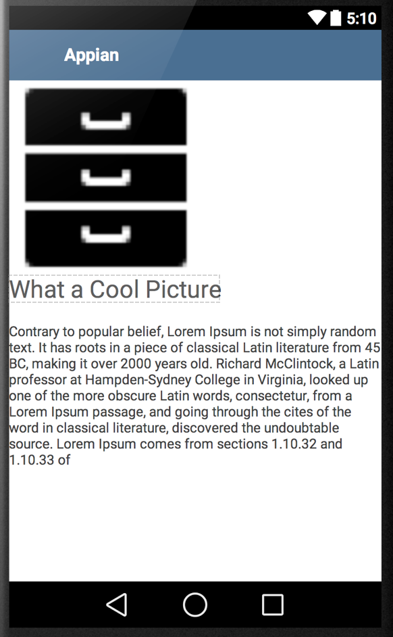
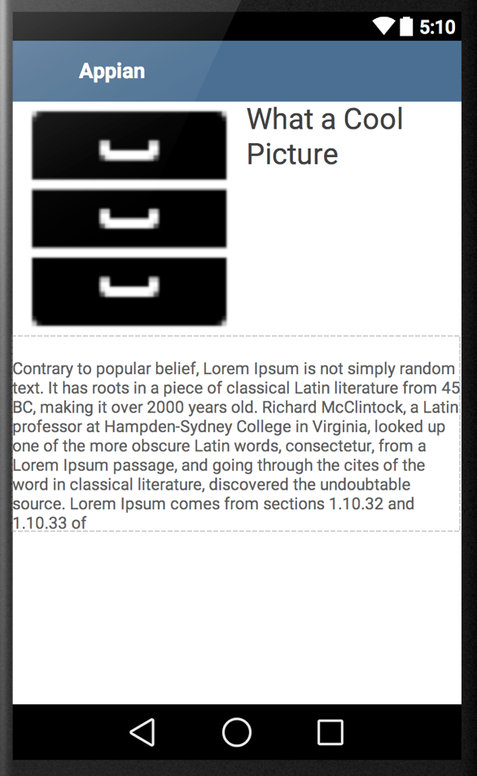
View Groups: Layouts
Linear Layout
Relative Layout
Notes:
To build a layout, you can put together multiple xml elements together in a view group
There are two basic types of View Groups.
Linear Layouts (that organize child views one after another)
Relative Layouts (that organize child views in relation to one another)
For more on Relative Layouts Vs Linear Layouts check out the developer docs
Linear Layouts are clearer to explain so we will discuss those in the presentation.
On this Linear Layout we have an image and two text views below it. These tags would look something like this in the xml we write.
However, this xml would not be complete without its attributes...

Slide 12
Relative Layout
<?xml version="1.0" encoding="utf-8"?>
<RelativeLayout >
<ImageView
id=@+id/image/>
<TextView
layout_toRightOf=@id/image/>
<TextView
layout_below=@id/image/>
</RelativeLayout>
Notes:
The linear layout uses attributes to define its width and height and the orientation of its child views (vertical or horizontal).
The child views also have attributes to define their dimensions, text size, colors, image and on and on.
This xml we see could be a standalone file that is used to lay out an activity. We will see how to make use of it later in the presentation.
We can note a couple things while we are here!
Width and height can be defined with:
“dp” (exact sizing)
wrap_content (minimum to hold content)
fill_parent (stretches to fill parent)
2) Text size is defined with “sp” (exact sizing for text)
3) There must be ONE root element in the xml file, this is normally a View Group (linear layout or relative layout) though it could be a view
4) Attributes in an xml file use a namespace (in this case android), all namespaces that are used need to be declared at the top of the file. You don’t need to worry about this too much unless you delete the auto generated one in the first element of the xml file.
5) The first line in an xml file defines the version and encoding. You dont need to worry about it, just make sure it’s in your file.

Slide 13
Playing with Layouts
See the changes here!
Notes:
Centering textview and button
Adding id to a textview
Positioning the button below the textview
Adding an EditView to type in the number above the textview

Slide 14
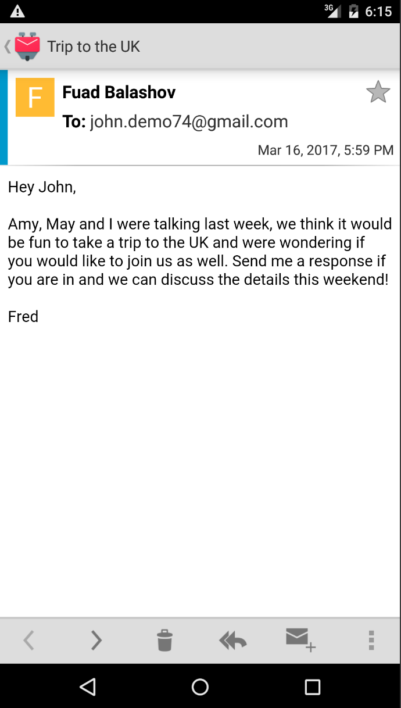
Intents
Intent
Data Bundle
Notes:
Fuad to end
Intents are used to start new activities, generally from another one.
In addition they hold a package of data for the next activity to read.
As you move through activities they are added onto an “Activity Stack”. When you hit the back button you are being transported to the last activity on the stack.

Slide 15
Navigating to a new Activity
See the changes here!
Notes:
Creating the new activity
Adding an intent to go from the first activity to the second one
Make sure it’s a linear layout with a vertical orientation!

Slide 16
Intents
Intent with Data
- New Activity
- Meme ID
Notes:
Intents are used to start new activities, generally from another one.
In addition they hold a package of data for the next activity to read.
As you move through activities they are added onto an “Activity Stack”. When you hit the back button you are being transported to the last activity on the stack.

Slide 17
Passing more info in our Intent
See the changes here!
Notes:
Passing the number the user types into the second activity via the intent

Slide 18

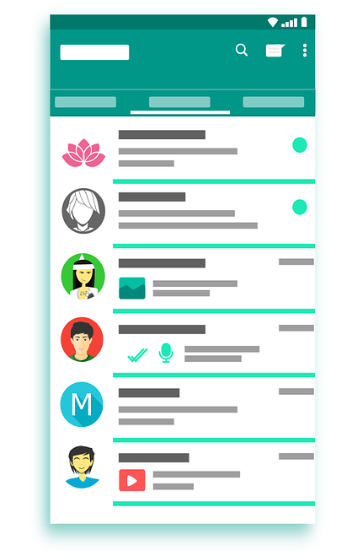

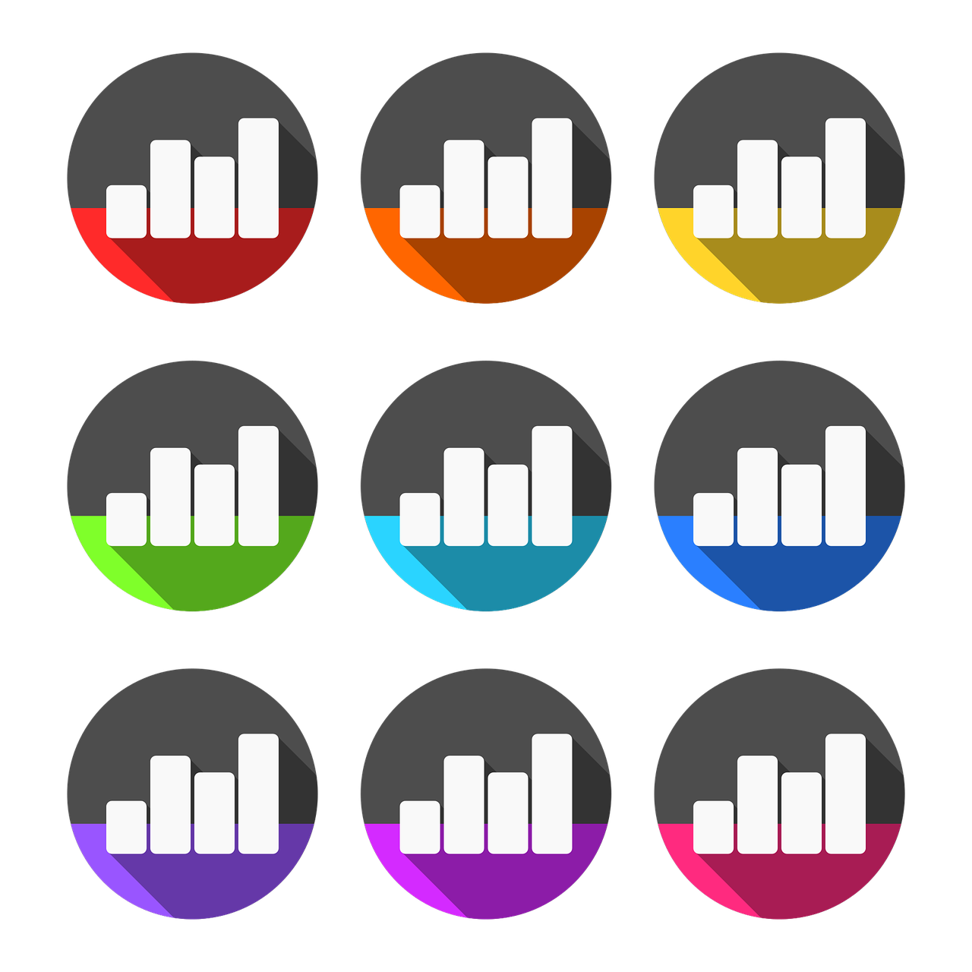
Interacting with APIs
Notes:
If you need information for your app. Look online
There are tons of apis you can use for weather data or sports data
Some of them you may need to get an authorization token
We are going to be using the imgur API to get our memes
We registered with the website and got a token we can use for this workshop
Images:
Phone from: https://pixabay.com/en/whatsapp-interface-apps-android-1660652/
Weather icon from: https://pixabay.com/en/april-weather-icon-warm-cold-mix-1371393/
Football from: https://commons.wikimedia.org/wiki/File:PICOL_icon_Football.svg by: Rodrigo.Argenton, licensed with: https://creativecommons.org/licenses/by/3.0/deed.en
Data icon: https://pixabay.com/en/analytics-stats-statistics-data-1919925/

Slide 19
Permissions
Camera
Bluetooth
Internet
File System
Geolocation
Notes:
Describe different applications of permissions
Camera
Bluetooth
Internet
File Systems
Geolocation
This is to protect users from malicious apps. Makes it clear to them what they are getting into
If you are downloading a new messaging app it makes sense for it to see your contacts, but it wouldn’t make sense for our meme generator app.
You add permissions to the ANdroid Manifest. We will add the internet permission in this exercise.

Slide 20
Networking with OkHttp
OkHttpClient
onFailure
(let the user know it failed)
onSuccess
(show the image)
Notes:
To make http calls (web requests) we need to have a client
Calls are asynchronus because we need to wait for a response from the network
We make a callback to handle both successful and failed requests.
We already created a meme client in the project. In this section we are going to:
Call it from our details activity
Make the network request
Handle the response
Show a toast on the ui thread
We use this same approach to interact with bluetooth and other apis that may take an unknown amount of time.

Slide 21
Networking
See the changes here!
Notes:
Write Meme code and display the meme

Slide 22
Networking
Activity
Type a Number
Intent
Activity
View a Meme
Network
AsyncTask
Number Id
Data
Notes:
We now have data coming back from the server.
We want to look at this data and get the url for the image from it.
When we need to show the image need to load the image from the url

Slide 23

Displaying our Memes
Our Response
Body: {
Data: [
{
Link: “www.imgur.com/meme1”,
Name: “Bad Luck Brian”
},
{
Link: “www.imgur.com/meme2”,
Name: “Leonardo Dicaprio Cheers”
}
...
]
}
Meme ID = 2
Picasso
Notes:
Using Third party libraries
Don’t write your own image loading/displaying library. See if one exists.
We are going to use Picasso, it is a great library for displaying images in android.
Add libraries in your build.gradle as a dependency
What is JSON?
Json is a format for transmitting data.
Most api’s will support JSON
We are already getting json in our onSuccess in the MemeClient and we need to pull the image url out of it.
Display what our json looks like
There are keys and values
We are going to drill through the keys to get our image link.

Slide 24
Showing our Meme
See the changes here!
Notes:
Write Meme code and display the meme

Slide 25




Local Data Storage
Shared Prefs
Primitive/String data
Great 4 Hacking!
Client Side DB
Objects
Heavyweight
Filesystem
Pictures
Files
Explanations and Demos
Notes:
We use SQLite as a client side DB
file based SQL Database
ex: Offline data
Cached responses for news feed, or actions list
Cached forms you fill out
User data
File System
pictures
Cached response contents
Shared Preferences let you store a primitive or string in the android filesystem. You identify it with a key which you can later use to retrieve it. It’s really easy to use so make use of it for hacking.
Images
Android with files: http://bitvbit.blogspot.com/2017/03/images.html licensed by BitByBit, with: https://creativecommons.org/licenses/by-sa/3.0/deed.en
SQLite: https://commons.wikimedia.org/wiki/File:SQLite370.svg
File Icon: https://en.wikipedia.org/wiki/File:Folder_Hexagonal_Icon.svg licensed by Anomie, with: https://creativecommons.org/licenses/by-sa/3.0/

Slide 26
Other Cool Stuff
Bluetooth
Camera
Maps
Lists & Grids: RecyclerViews
IOT for Android
Libraries for Everything
Speech Recognition, Barcode Scanning

Slide 27
Congratulations!
Please fill out this short survey to help us improve this workshop!
ap.pn/2iNIl0m
Stop by if you have any questions
GLHF!

